Slide 1










VISVESVARAYA TECHNOLOGICAL UNIVERSITY
BELAGAVI KARNATAKA – 590018
A PRESENTATION ON
“SOCIAL CONNECTIVITY AND RESPONSIBILITY ”
PLACEMENT OFFICER
PROF.RAMLING NATIKAR
Department Of Civil Engineering
Government Engineering College
Raichur-584135
2023-2024
Presented By
NAME : VASANTH KUMAR
USN : 3GU23CV437

Slide 2
TABLE OF CONTENTS
MODULE 1: ORGANIC FARMING AND WAST MANAGEMENT
MODULE 2: WATER CONSERVATIVE
MODULE 3: FOODWALK
MODULE 4: PLANTATION AND ADAPTION OF TREE
MODULE 5: HERITAGE WALK AND CRAFT CORNER

Slide 3
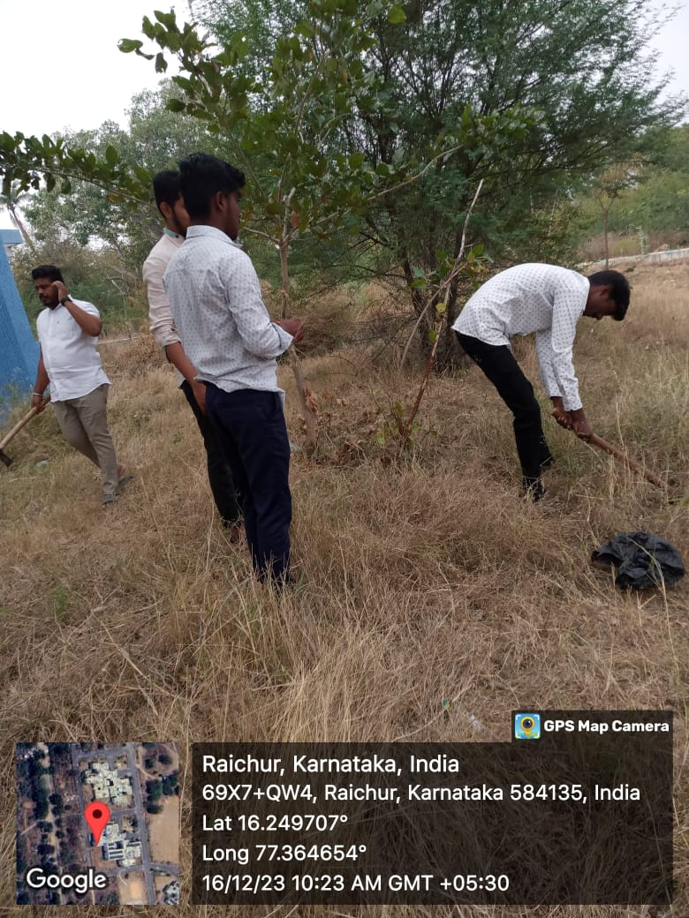
ORGANIC FARMING AND WASTE MANAGEMENT
Introduction
Organic Farming has emerged as a sustainable and environmentally friendly alternative to conventional agriculture, promoting soil health, biodiversity, and overall ecosystem balance. This essay delves into the principles and practices of organic farming, where the cultivation of tomatoes, corn, and vegetables is carried.
Principles And Practices Of Organic Farming
Soil Health Management :
Importance of healthy soil and Soil conservation methods
in organic farming. Cover cropping and crop rotation.
Pest and Disease Management :
Biological pest control and Companion planting.
Use of organic pesticides

Slide 4
WASTE MANAGEMENT IN ORGANIC FARMING
Cow Dug as Organic Manure
Nutrient content of cow dung and Composting techniques. Application methods in organic farming.
Utilization of Farm Waste
Crop residues and their benefits and Cover cropping for waste management. Creating a closed-loop system.
Organic Farming Practices at Raichur
Crop selection and rotation and Integration of livestock. Water conservation and efficient irrigation.

Slide 5
WASTE MANAGEMENT
Waste management or waste disposal includes the processes and actions required to manage waste from its inception to its final disposal.
This includes the collection, transport, treatment, and disposal of waste.
Waste can be solid, liquid, or gases and each type has different methods of disposal and management.
Waste management deals with all types of waste, including industrial, biological, household, municipal, organic, biomedical, radioactive wastes.
In some cases, waste can pose a threat to human health. Health issues are associated with the entire process of waste management

Slide 6
ADVANTAGES | DIS-ADVANTAGES
It helps in controlling flood and soil erosion | Expensive food items
It helps in utilization of rainwater for the purpose of irrigation | Rarely subsidized farming method.
It reduces the cost of water in water bills. | Insufficient knowledge & skills
The conserved water can be used for the purpose of sanitation | The crop is susceptible to illness.

Slide 7
WATER CONSERVATION
Introduction
Water, the elixir of life, is an invaluable resource essential for all living organisms.
As the global population continues to burgeon and climate change exacerbates water scarcity, the need for effective water conservation practices has become paramount.
This report delves into the significance of water conservation, focusing on a model observed at the GKVK College, an agricultural institution, where a massive conservation tank plays a pivotal role in sustainable water management for agricultural purposes.

Slide 8
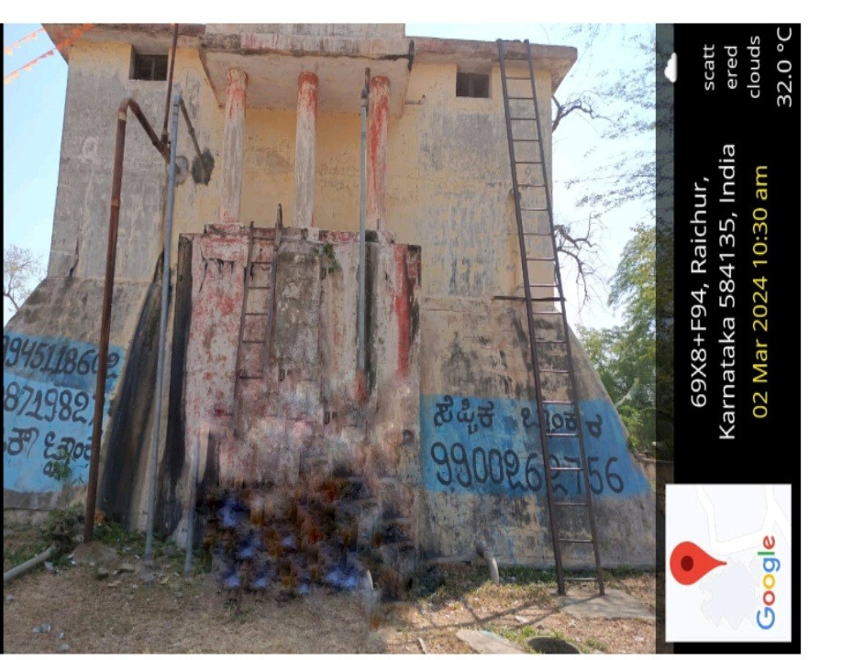
YERAMURAS CAMP WATER TANK
Yaramarus camp a renowned agricultural institution, serves as an exemplary model for sustainable water management in agriculture.
During our visit, we were introduced to a colossal water conservation tank with a capacity of 98,100 litres.
This tank serves as a reservoir for rainwater harvesting, efficiently collecting and storing precipitation during the monsoon season.
Installed by: Agri Farm Corporation
Name: Modular water storage Capacity: 98100 litres
Size: 6.40m height= 3.05 m
Outlets: water discharge Drainage Water indicator Water overflow

Slide 9
BENEFITS OF THE CONSERVATION TANK
Mitigating Water Scarcity:
The primary objective of the conservation tank is to mitigate water scarcity by harnessing rainwater, reducing dependence on conventional water sources.
Promoting Sustainable Agriculture:
By utilizing harvested rainwater for irrigation, the college promotes sustainable agriculture, ensuring the longevity of soil fertility and crop yields.
Groundwater Recharge:
The conservation tank also contributes to groundwater recharge, preventing the depletion of aquifers and ensuring a sustainable supply of water for the future.
Cost-Effective Solution:
Rainwater harvesting is a cost-effective solution compared to alternative methods, as it requires minimal infrastructure and maintenance expenses

Slide 10
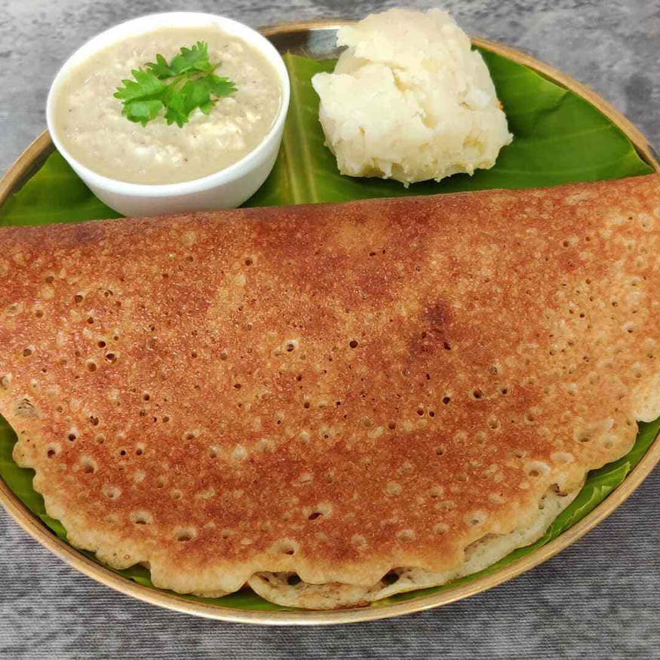
FOOD WALK
INTRODUCTION
Raichur district forms a part of the North Karnataka and being on the boundaries of the state the cuisine of Raichur is influenced by the Neighbouring state of Andhra Pradesh. Having been blessed with rich fertile land and flourishing agricultural produce, the food in this region is never going to disappoint you.
The people in this region love to cook up mouth-watering delicacies with the ample amount of nature bounties that they have been blessed with. Some of the frequent ingredients used in the cuisine of Raichur are jowar, wheat, rice, peanuts and garlic.

Slide 11
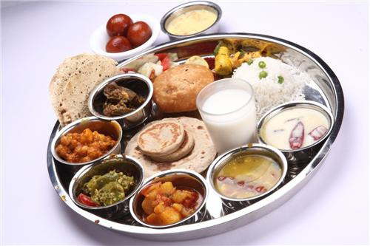
In case you have never tasted South Indian food, you may start with a typical thali lunch. Oh yes! there is definitely more to South Indian cuisine than just Dosa or Idly. Thali is nothing but a steel plate, although in star hotels you might get the same thali on a bone china plate. So, now that you have ordered a thali, what is it that you are going to get on your plate. A typical thali is laden with all the local dishes of the area, items like pickle, salad (kosambri), pallya (shallow fried vegetable pieces with a bit of urad or chana dal, spices and sometimes shreds of fresh coconut), lentil (daal), chutneys (sometimes dry chutneys in the form of powder), curd, rice, bread (chapati, rotti), more curries, curd rice and a sweet dish. All these dishes in a typical thali are not only tasty but also very healthy with minimal use of oil.

Slide 12
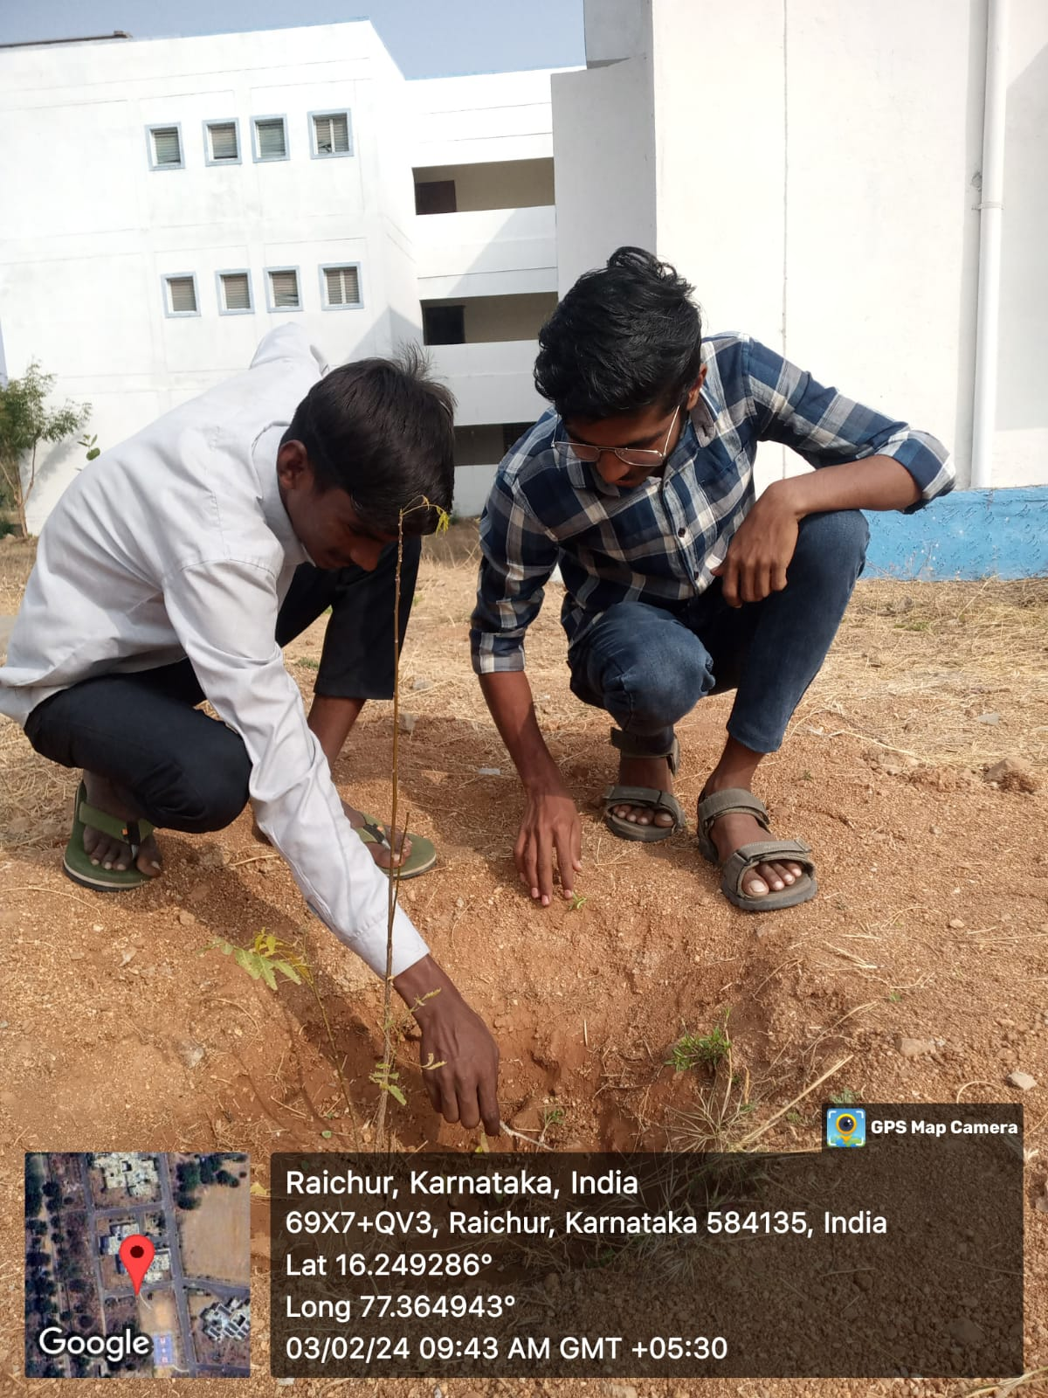
PLANTATION AND ADAPTION OF NEEM TREE
Inducing a neem tree involves planting it in well-drained soil, preferably in a sunny location. Ensure the soil is rich in organic matter and has a slightly acidic to neutral pH.
Water the tree regularly, especially during dry periods, but avoid waterlogging the soil.
Neem trees are relatively low-maintenance but may benefit from occasional pruning to maintain shape and remove dead or diseased branches. Additionally, applying organic mulch around the base of the tree can help conserve moisture and suppress weeds.

Slide 13
Medicinal Properties: Neem is known for its medicinal properties, used in traditional medicine for treating various ailments such as skin infections, diabetes, and inflammation. Pest Control: Neem extracts act as natural pesticides, deterring pests and insects from damaging crops. Fertilizer: Neem leaves and oil can be used as organic fertilizers, enriching the soil with essential nutrients. Dental Health: Neem twigs are traditionally used as natural toothbrushes, promoting dental hygiene and reducing oral bacteria. Skin Care: Neem oil is used in skincare products for its antibacterial and antifungal properties, helping to treat acne, eczema, and other skin conditions. Hair Care: Neem oil is beneficial for scalp health, reducing dandruff and promoting hair growth.
ADVANTAGES OF NEEM TREE

Slide 14
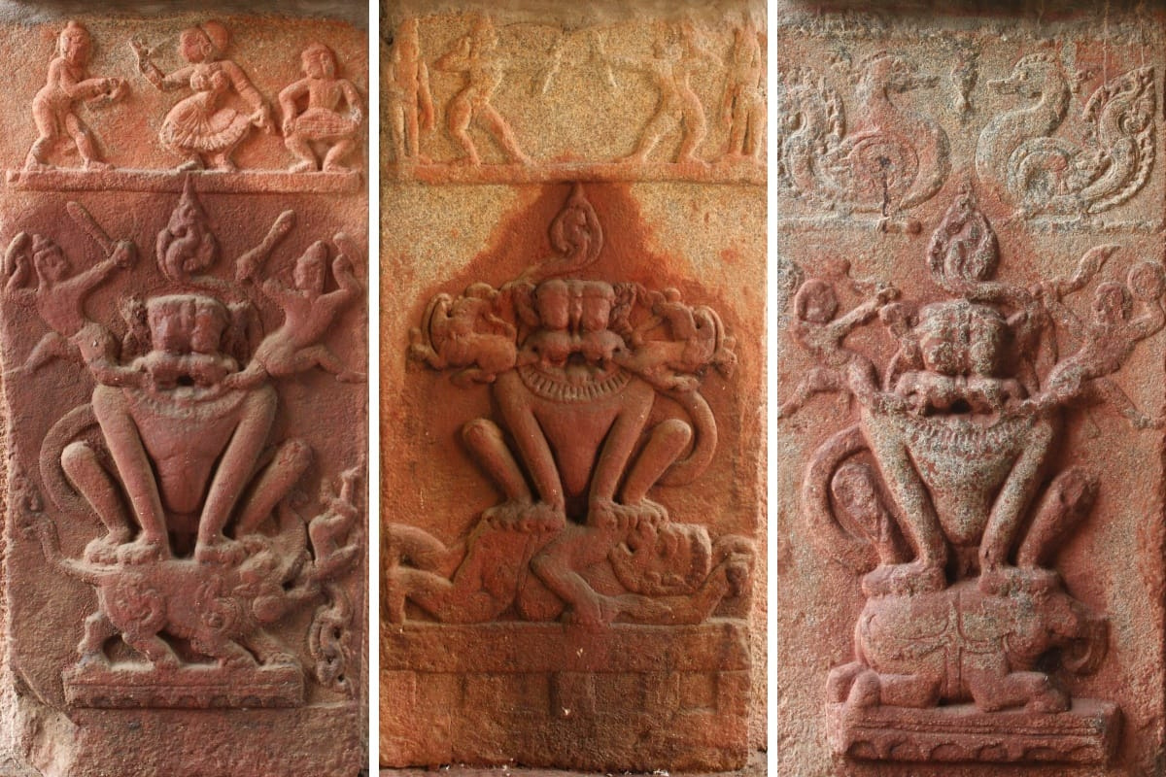
HERITAGE WALK AND CRAFT CORNER
Introduction
During a recent heritage walk in Raichur, I had the privilege of visiting Raichur fort and museum an ancient gateway that stands as a historical marvel in the town. This report details my visit to the Navranga Darwaza Museum, providing insights into its history, architecture, and the cultural treasures it house.
Fig Lord Narasimha

Slide 15
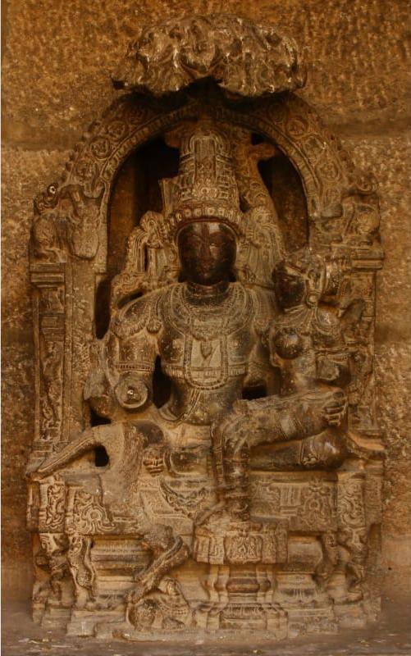
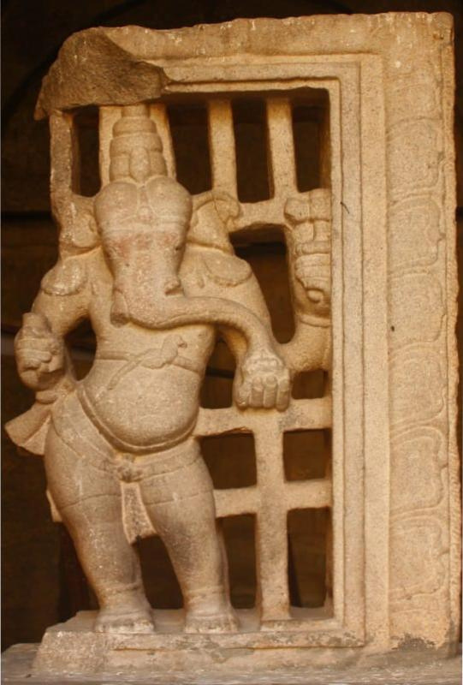
The Recorded history of the district is traced as far back as the third century BCE , The fact that 3 minor rocks edicts of Ashoka are found in District 1ˢᵗ at Maski in Lingasuguru Taluk and the other 2 are near Koppala, which proves that the area was included in the dominion of the great Maurya King Ashoka (273-236 B.C.E) At that time, this region was under the governance of the vicerory or Mahamatra of Ashoka. Thereafter, the district appears to have been a part of the kingdom of the shatavahanas.
Fig Lord Uma - Maheshwari And Lord Ganesh

Slide 16
THANK YOU

